Slide 1
DSA – L13

Slide 2
Think about a sorted doubly linked list as a structure for dynamic sets.
What is the running time of:
    Successor?
    Search()?
    Insert()?

Slide 3
Think about a sorted doubly linked list as a structure for dynamic sets.
What is the running time of:
  Successor() ------ O(1)
  Search() ---- O(n)
  Insert() ------ O(n)
    Goal : Make these O(lgn) expected time in a linked-list setting!

Slide 4
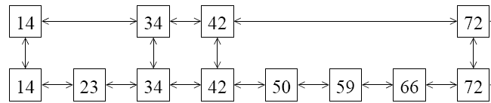
Motivation for the skipping
Let’s add an express lane.
Can quickly jump from express stop to next express stop, or from any stop to next normal stop.
To search, first search in the express layer until about to go to far, then go down and search in the local layer.

Slide 5



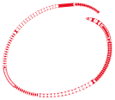


(Perfect) Skip Lists
A skip list is a collection of lists at different levels
The lowest level (0) is a sorted, singly linked list of all nodes
The first level (1) links alternate nodes
The second level (2) links every fourth node
In general, level i links every 2ith node
In total, ⎡log2 n⎤ levels (i.e. O(log2 n) levels).
Each level has half the nodes of the one below it
S₃
−∞
+∞
S₂
−∞
31
+∞
S₁
−∞
23
31
44
64
+∞
S₀
−∞
12
23
26
31
34
44
56
64
+∞

Slide 6
(Perfect) Skip Lists – Insertion / Deletion
When we add a new node, our beautifully precise structure might become invalid.
We may have to change the level of every node
One (sneaky) option is to move all the elements around
Both options take O(n) time, which is back where we began
Is it possible to achieve a net gain?

Slide 7
Randomized Skip Lists
S₃
−∞
+∞
S₂
−∞
31
+∞
S₁
−∞
23
31
34
64
+∞
S₀
−∞
12
23
26
31
34
44
56
64
78
+∞

Slide 8
Definition of Skip Lists
A skip list for a set S of distinct (key, element) items is a series of lists S0, S1 , … , Sh such that:
  Each list Si contains the special keys +∞ and -∞
  List S0 contains the keys of S in nondecreasing order
  Each list is a subsequence of the previous one, i.e.,
  S0 ⊇ S1 ⊇ … ⊇ Sh
  List Sh contains only the two special keys

Slide 9
Randomized Skip Lists – Initialization
A new list is initialized as follows:
  A node NIL (+∞ ) is created and its key is set to a value greater than the greatest key that could possibly used in the list
  Another node NIL (-∞) is created, value set to lowest key that could be used
  The level (high) of a new list is 1
  All forward pointers of the header point to NIL

Slide 10

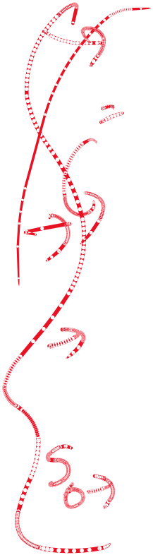








Randomized Skip Lists – Search
We search for a key x in a skip list as follows:
  We start at the first position of the top list
  At the current position p, we compare x with y ← key(after(p))
  x = y: we return element(after(p))
  x > y: we “scan forward”
  x < y: we “drop down”
  If we try to drop down past the bottom list, we return NO_SUCH_KEY
Example: search for 78
S₃
−∞
+∞
S₂
−∞
31
+∞
S₁
−∞
23
31
34
64
+∞
−∞
12
23
26
31
34
44
56
64
78
+∞

Slide 11


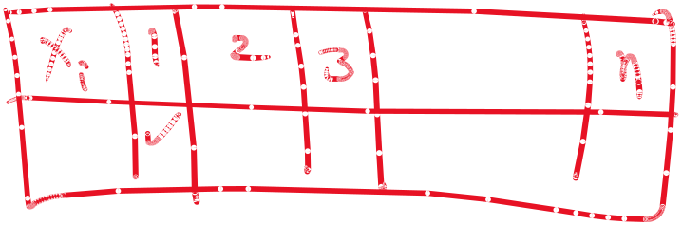


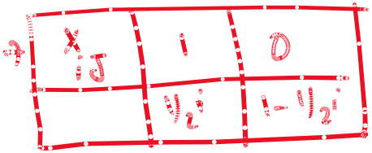




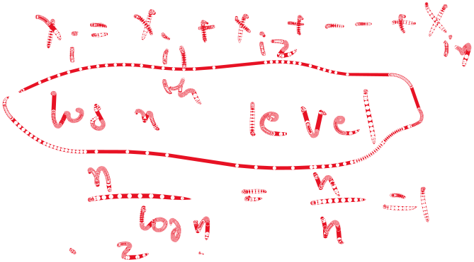
















S₃
−∞
+∞
S₂
−∞
31
+∞
S₁
−∞
23
31
34
64
+∞
−∞
12
23
26
31
34
44
56
64
78
+∞

Slide 12
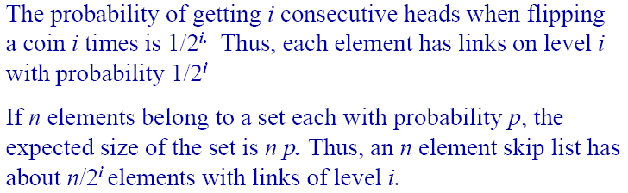
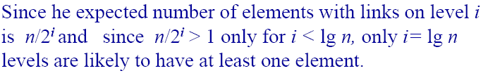
Randomized Skip Lists – Probabilistic Analysis

Slide 13
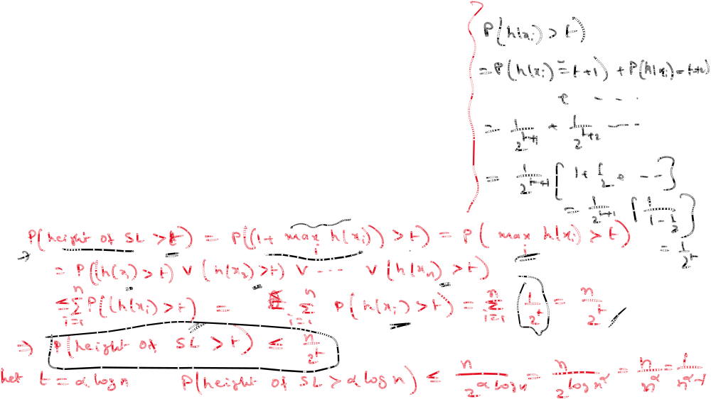
S₃
−∞
+∞
S₂
−∞
31
+∞
S₁
−∞
23
31
34
64
+∞
−∞
12
23
26
31
34
44
56
64
78
+∞

Slide 14
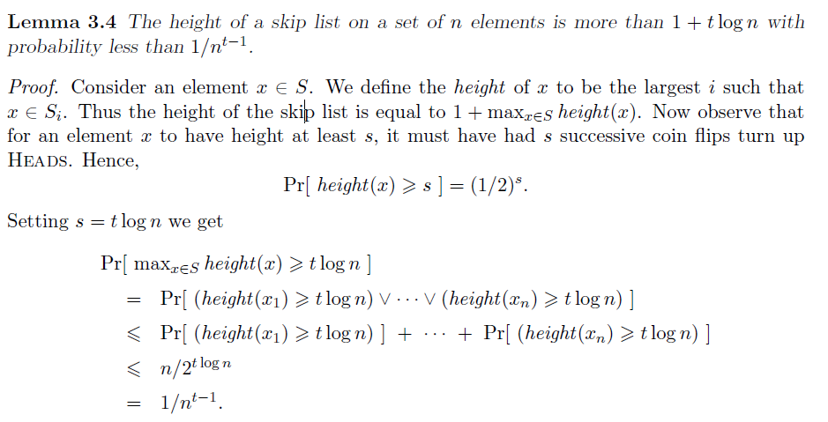
Randomized Skip Lists – Probabilistic Analysis
Lemma

Slide 15
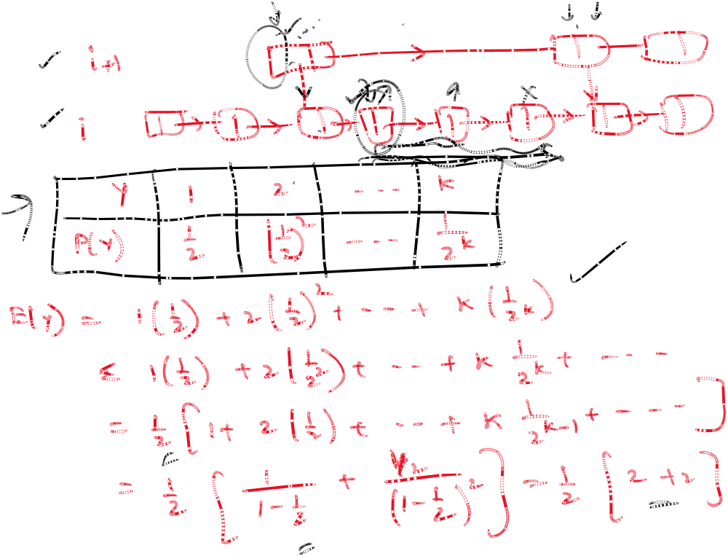


Slide 16
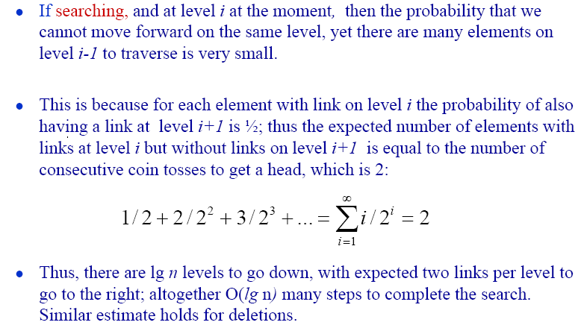
Randomized Skip Lists – Probabilistic Analysis

Slide 17
Randomized Skip Lists – Insert
The insertion algorithm for skip lists uses randomization to decide how many references to the new item (k,e) should be added to the skip list
We then insert (k,e) in this bottom-level list immediately after position p. After inserting the new item at this level we “flip a coin”.
If the flip comes up tails, then we stop right there. If the flip comes up heads, we move to next higher level and insert (k,e) in this level at the appropriate position.

Slide 18
Randomized Skip Lists – Insert – An example
Suppose we want to insert 15
Do a search, and find the spot between 10 and 23
Suppose the coin come up “head” three times
S₃
−∞
+∞
p₂
S₂
−∞
+∞
S₂
−∞
15
+∞
p₁
S₁
−∞
23
+∞
S₁
−∞
15
23
+∞
p₀
S₀
−∞
10
23
36
+∞
S₀
−∞
10
15
23
36
+∞

Slide 19
Randomized Skip Lists – Deletion
We begin by performing a search for the given key k. If a position p with key k is not found, then we return the NO SUCH KEY element.
Otherwise, if a position p with key k is found (it would be found on the bottom level), then we remove all the position above p
If more than one upper level is empty, remove it.

Slide 20
Randomized Skip Lists – Deletion – An example
Suppose we want to delete 34
Do a search, find the spot between 23 and 45
Remove all the position above p
S₃
−∞
+∞
p₂
S₂
−∞
34
+∞
S₂
−∞
+∞
p₁
S₁
−∞
23
34
+∞
S₁
−∞
23
+∞
p₀
S₀
−∞
12
23
34
45
+∞
S₀
−∞
12
23
45
+∞

